Slide 1
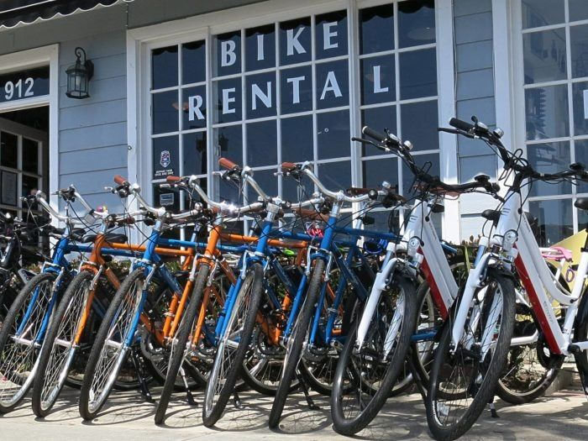
Bike Sharing Demand Analysis Project Using Excel
By Kashish Mehta
A Project By Nexthikes IT Solutions

Slide 2


PROBLEM STATEMENT
Analyzing bike-sharing data helps understand how weather, time, and holidays affect bike rentals. This project uses Excel skills to clean, combine, and study datasets to find useful patterns that improve business planning.

Slide 3
Data Description
Source and Context: The dataset details hourly and daily usage data for a bicycle sharing system. The goal of the project is to predict the total rental count (cnt) based on environmental and temporal factors.
Key Numeric Predictors: The raw data provides essential continuous metrics like Temperature (temp), Feeling Temperature (atemp), Humidity (hum), and Windspeed (windspeed).
Key Code-Based Predictors: The data uses numeric codes for categorical information, which require decoding: weekday (0-6): Day of the week.
weathersit (1-4): Severity of weather conditions.

Slide 4
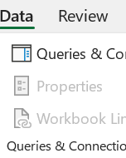
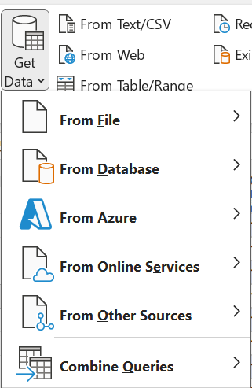
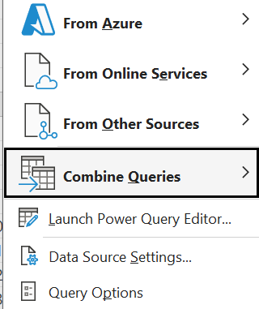
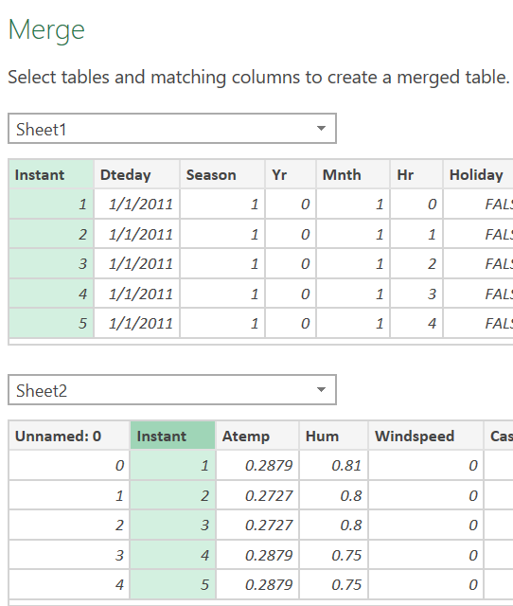
Data Merge Process
We are using these steps to merge data
First of all, Click the Data Tab
After that, click on the Get Data
Then use the Combine Queries
Then use the Merge option to merge all sheets one by one

Slide 5
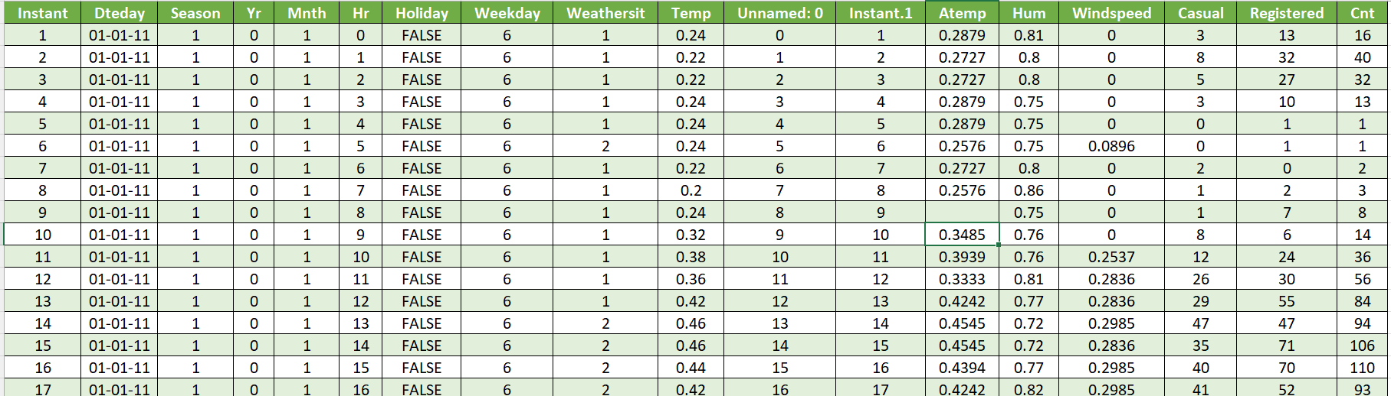
Data Cleaning Step 1: Handling Duplicates
Issue Identification: After merging sheet 1 & sheet 2, I get a duplicate heading Instant.1, which is highlighted below

Slide 6
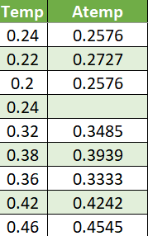
Data Cleaning Step 2: Filling Missing Values
In the data of the Atemp Column, I get some missing cells, so I filled the missing cells by using the formula
IF (K2="", 1.2 * I2, K2)

Slide 7
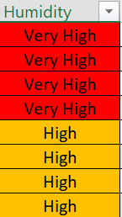
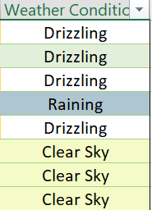
Environmental Features: Humidity and Weather Conditions
Converted the continuous hum value into high-impact bins (categories).
Decoded the weathersit numeric codes (1-4) into descriptive text labels

Slide 8
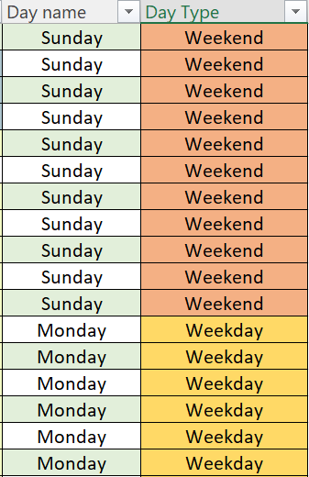
Temporal Features: Calculating Day Name and Day Type
Purpose: Converted the weekday code (0-6) into a recognizable (Day Name) for readability.
Grouped days into "Weekday" vs. "Weekend" to get the details of the Impact on Bike Rental

Slide 9
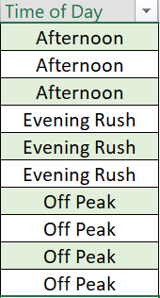
Time Of Day
We transformed the raw Hour (hr) column into the Time of Day feature to convert raw timestamps (0-23) into meaningful behavioral categories like 'Rush Hour' and 'Off Peak'

Slide 10
Bike Count by Hour Group and Day Type
Weekday demand (Blue Bars) is highest during Evening Rush (12,311 count) and Morning Rush (10,641 count).
Weekend demand (Orange Bars) in the Morning Rush is extremely low (only 758 count), proving that the weekday commuter pattern vanishes on weekends.
The Afternoon category has the highest weekend usage (7,300 count), indicating weekends are driven by leisure and non-work travel.
The difference in usage between Weekday and Weekend is largest during the Morning Rush (approx 10,000 difference), highlighting where operational strategies must differ most.

Slide 11
Bike Rides by Weather Situation
Clear Sky drives the majority of demand, accounting for 64% of all total rentals.
Ridership shows high tolerance, with 31% of rentals occurring despite Drizzling or light conditions.
Demand collapses to only 5% during Raining conditions, confirming the weather threshold for service interruption.
Operational strategy must focus on the two dominant conditions (Clear Sky and Drizzling), which cover 95% of all usage.

Slide 12
Humidity Level Wise Report
High usage occurs across both humidity levels, indicating humidity is not a strong deterrent to ridership.
Total bike rentals dropped significantly from January to February for both High and Very High humidity.
Very High Humidity (Orange Line) correlated with higher rental volume than High Humidity in January.
The gap between High and Very High humidity rental counts narrows significantly in February.

Slide 13
Average Bike Count by Hour
The system follows a predictable bi-modal curve, confirming two major peak demands daily.
The highest average demand occurs during the Evening Rush, peaking around 5 PM to 6 PM (hour 17) with approximately 140 average rentals.
The secondary peak occurs during the Morning Rush (hour 8) with approximately 130 average rentals.
Demand hits its lowest point between 3 AM and 5 AM, indicating the best window for major maintenance or system resets.

Slide 14
Average Hourly Demand: Weekday vs Weekend
This chart gives us the single most important lesson: Our customers are two completely different groups depending on the day.
On the Weekdays (Blue Bars), we see demand spike like a rollercoaster—that's the commuters heading to and from work.
But look at the Weekends (Orange Bars): the morning rush vanishes! Demand is much flatter and peaks later in the Afternoon—that's the leisure riders.

Slide 15
Average Hourly Demand: Registered vs Casual
The Orange Line (Registered Weekday) shows extreme predictability with two massive peaks at 8 AM and 5-6 PM.
The Blue Line (Casual Weekday) remains extremely flat and close to zero throughout the entire day. This confirms that Casual Users are not contributing to the rush hour problem. Their demand is minimal during the work week.
On weekends, the demand curve flattens out, and the Yellow Line (Registered Weekend) and Grey Line (Casual Weekend) move closer together, peaking later (1 PM to 4 PM). While Registered users still dominate, the relative contribution of casual users is significantly higher on weekends than on weekdays.

Slide 16
Thank you

